Slide 1
Cost Estimation

Slide 2
Project Cost Management
Project cost management includes the processes required to ensure that a project team completes a project within an approved budget.
The project manager’s job is to satisfy project stakeholders while continuously striving to reduce and control costs.

Slide 3
Key Processes in Project Cost Management
Planning cost management
Estimating costs and determining the budget
Controlling costs

Slide 4
Project/Software Cost- Parameters
Size: Usually measured in LOC or the number of Function Points required to realize the desired capabilities.
Function Points – a better metric earlier in the project
LOC (SLOC, KLOC…) a better metric later in the project
Project/Process Complexity: – Complex projects with intricate requirements, integration challenges, or advanced functionalities may require more resources and budget.
Process

Slide 5
Project/Software Cost- Parameters
Personnel – capabilities of the personnel in general and in the application domain in particular
All human resources involved in the project, from technical staff to project managers. Skilled labor is often the largest cost component, especially in technical or labor-intensive projects.
There is much specialization nowadays. Some are expensive.
Emphasize ‘team’ and team responsibilities…Ability to work in a team;
Several newer lightweight methodologies are built around a team or tiny group of individuals…

Slide 6
Project/Software Cost- Parameters
Environment – The tools/techniques / automated procedures used to support the development effort.
Integrated tools; automated tools for modelling, testing, configuration, managing change, defect tracking, etc…
Required Quality of the Project – the functionality provided; performance, reliability, maintainability, scalability, portability, user interface utility; usability…

Slide 7
Project/Software Cost- Parameters
Effort = (personnel)(environment)(quality)(size)(process)

Slide 8
Cost of a Project
The cost in a project is due to:
due to the requirements for software, hardware, and human resources
the cost of software development is due to the human resources needed
most cost estimates are measured in person-months (PM)
The cost of the project depends on the nature and characteristics of the project,
At any point, the estimate’s accuracy will depend on the amount of reliable information we have about the final product.

Slide 9
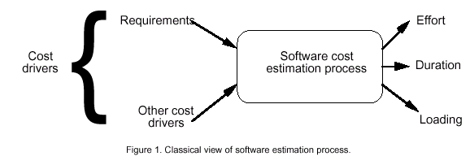
Software/Project Cost Estimation

Slide 10
Introduction to COCOMO models
The COstructive COst Model (COCOMO) is the most widely used software estimation model
The COCOMO model predicts the effort, resource, and duration of a project based on inputs relating to the size of the resulting systems and a number of "cost drives" that affect productivity.

Slide 11
Effort
Effort Equation
PM = C * (KDSI)^{n} (person-months)
where PM = number of person-month (person-152 working hours),
C = a constant,
KDSI = thousands of "delivered source instructions" (DSI) and
n = a constant.

Slide 12
Productivity
Productivity equation
(DSI) / (PM)
where PM = number of person-month (=152 working hours),
DSI = "delivered source instructions"

Slide 13
Schedule
Schedule equation
TDEV = C * (PM)^{n} (months)
where TDEV = number of months estimated for software development.

Slide 14
Average Staffing
Average Staffing Equation
(PM) / (TDEV) (FSP)
where FSP means Full-time-equivalent Software Personnel.

Slide 15
Cost Estimation Process
Effort
Size Table
Lines of Code
Number of Use Case
Function Point
Development Time
Estimation Process
Number of Personnel
Errors

Slide 16
Types of Software Projects Mode
The most important factor contributing to a project's duration and cost is the Development Mode
Organic Mode: The project is developed in a familiar, stable environment, and the product is similar to previously developed products. The product is relatively small and requires little innovation.
Semidetached Mode: The project's characteristics are intermediate between Organic and Embedded. development consisting of a mix of experienced and inexperienced staff.
Embedded Mode: The project is characterized by tight, inflexible constraints and interface requirements. An embedded mode project will require a great deal of innovation.

Slide 17
COCOMO I
COCOMO 1 is primarily based on the number of lines of code (LOC) as the primary measure of software size.
It provides a good rough estimation
COCOMO has three different models (each one increasing with detail and accuracy):
Basic, applied early in a project. Use for quick and rough cost calculations for the software
Intermediate, applied after requirements are specified.
Advanced, applied after the design is complete
COCOMO has three different modes:
Organic – “relatively small software teams develop software in a highly familiar, in-house environment”
Embedded – operate within tight constraints, product is strongly tied to “complex of hardware, software, regulations, and operational procedures”
Semi-detached – intermediate stage somewhere between organic and embedded. Usually up to 300 KDSI

Slide 18
BASIS COCOMO
COCOMO uses two equations to calculate effort in Person-Months (PM) and the number of months estimated for the project (TDEV)
PM (or Effort) is based on the number of thousand lines of delivered instructions/source (KDSI)
PM = a(KDSI)^{b} * EAF (EAF for intermediate model)
TDEV = c(PM)^{d}
EAF is the Effort Adjustment Factor derived from the Cost Drivers, EAF for the basic model is 1
The values for a, b, c, and d differ depending on which mode you are using
Mode | a | b | c | d
Organic | 2.4 | 1.05 | 2.5 | 0.38
Semi-detached | 3.0 | 1.12 | 2.5 | 0.35
Embedded | 3.6 | 1.20 | 2.5 | 0.32
Notes:
The Intermediate Model estimates the software development effort by using fifteen cost driver variables besides the size variable used in Basic COCOMO.
Product Attributes
RELY: Required Software Reliability The extent to which the software product must perform its intended functions satisfactorily over a period of time.
DATA: Data Base Size The degree of the total amount of data to be assembled for the data base.
CPLX: Software Product Complexity The level of complexity of the product to be developed.
Computer Attributes
TIME --- Execution Time Constraint The degree of the execution constraint imposed upon a software product.
STOR --- Main Storage Constraint The degree of main storage constraint imposed upon a software product.
VIRT --- Virtual Machine Volatility The level of the virtual machine underlying the product to be developed.
TURN --- Computer Turnaround Time The level of computer response time experienced by the project team developing the product.
Personnel Attributes
ACAP: Analyst Capability The level of capability of the analysts working on a software product.
AEXP: Applications Experience The level of applications experience of the project team developing the software product.
PCAP: Programmer Capability The level of capability of the programmers working on the software product.
VEXP: Virtual Machine Experience The level of virtual machine experience of the project team developing the product.
LEXP: Programming Language Experience The level of programming language experience of the project team developing the product.
Project Attributes
MODP: Use of Modern Programming Practices The degree to which modern programming practices (MPPs) are used in developing software product.
TOOL: Use of Software Tools The degree to which software tools are used in developing the software product.
SCED: Schedule Constraint The level of schedule constraint imposed upon the project team developing the software product.

Slide 19
COCOMO 1
A simple example:
Project is a flight control system (mission critical) with 310,000 DSI in embedded mode
Reliability must be very high (RELY=1.40). So we can calculate:
Effort = 1.40*3.6*(310)^{1.20} = 5093 MM
Schedule = 2.5*(5093)^{0.32} = 38.4 months
Average Staffing = 5093 MM/38.4 months = 133 FSP

Slide 20
Intermediate COCOMO
The intermediate model is an extension of the basic model and includes a set of cost drivers to calculate the estimates with better accuracy. The effort factor includes the effort adjustment factor (EAF) that is calculated with the cost drivers.
PM (or Effort) = a(KDSI)^{b} * EAF
TDEV = c(PM)^{d}

Slide 21
Intermediate COCOMO-Cost drivers
Product Attributes
Product Attributes | Very Low | Low | Nominal | High | Very High | Extra High
RELY | 0.75 | 0.88 | 1.00 | 1.15 | 1.40 | ...
DATA | ... | 0.94 | 1.00 | 1.08 | 1.16 | ...
CPLX | 0.70 | 0.85 | 1.00 | 1.15 | 1.30 | 1.65
RELY: Reliability DATA: Data size CPLX = Complexity

Slide 22
Intermediate COCOMO-Cost drivers
Hardware attributes
Hardware Attributes | Very L ﻿ow | Low | Nominal | High | Very High | Extra High
TIME | ... | ... | 1.00 | 1.11 | 1.30 | 1.66
STOR | ... | ... | 1.00 | 1.06 | 1.21 | 1.56
VIRT | ... | 0.87 | 1.00 | 1.15 | 1.30 | ...
TURN | ... | 0.87 | 1.00 | 1.07 | 1.15 | ...
Time= Run time performance constraints STOR: Memory constraints VIRT= Volatility of the virtual machine
TURN= Required turnaround time

Slide 23
Intermediate COCOMO-Cost drivers
Personal attributes
Analyst capabilities
Software engineering capabilities
Applications experience
Virtual machine experience
Programming language experience
Personal attributes | Very Low | Low | Nominal | High | Very High | Extra High
ACAP | 1.46 | 1.19 | 1.00 | 0.86 | 0.71 | ...
AXEP | 1.29 | 1.13 | 1.00 | 0.91 | 0.82 | ...
PCAP | 1.42 | 1.17 | 1.00 | 0.86 | 0.70 | ...
VEXP | 1.21 | 1.10 | 1.00 | 0.90 | ... | ...
LEXP | 1.14 | 1.07 | 1.00 | 0.95 | ... | ...

Slide 24
Example
Suppose a project was estimated to be made in 400 kLOC. let's calculate its effort, time, and the number of people required while considering the project is of organic type and has a nominal complexity. The developer has a high virtual machine experience.
The value of the nominal complexity of a project is 1.00, and the high virtual experience of the developer is 0.90, according to the tables mentioned above:
EAF=1.00∗0.90=0.9
Effort(E)=2.4(400 kLOC)1.05∗0.9=1554.37 person−months
Time(T)=2.5(1554.37)0.38=40.80 months
People required=1554.37/40.80​=38.09 persons

Slide 25
Detailed Model of COCOMO
Detailed COCOMO incorporates all characteristics of the intermediate version with an assessment of the cost driver’s impact on each step of the software engineering process. The Six phases of detailed COCOMO are:
Planning and requirements
System design
Detailed design
Module code and test
Integration and test
Cost Constructive model

Slide 26
Function Point Analysis (FPA)
A method used for software cost estimation based on the functionality provided by the software. It quantifies the software's functionality by measuring the number of function points, which represent the inputs, outputs, inquiries, internal logical files, and external interfaces.

Slide 27
Function Point Analysis (FPA)..
STEP 1: Identify Function Types
Function points are computed by first calculating an unadjusted function point count (UFC). Counts are made for the following categories
External inputs (User Input) - Represent user inputs that affect the internal processing of the software and result in data being maintained or altered by the system. Examples include forms, data entry screens, or file imports.
External outputs – These are outputs the system provides to the user, which involve processing. Such as reports and messages.

Slide 28
Function Point Analysis (FPA)..
External inquiries – These are interactive inputs that retrieve data from the system without altering any data. External Inquiries capture user requests for information from the system and the system's response in providing that information. Examples are search forms or queries.
External Interface files – These are external data files accessed by the system but not maintained by it. E.g., machine-readable interfaces to other systems
Internal files – The internal data maintained by the system, like database tables or files created and used within the application. Logical master files in the system

Slide 29
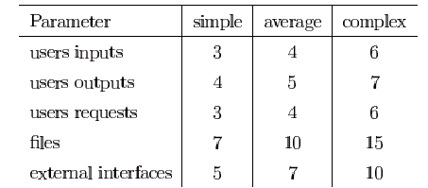
Function Point Analysis (FPA)..
STEP 2: Multiply each number by a weight factor, according to the complexity (simple, average or complex) of the parameter, associated with that number and find the Unadjusted Function Point (UFP). The value is given by a table:

Slide 30
Function Point Analysis (FPA)..
STEP 3: Find DI (Degree of Influence) using the TCF table (a separate table)
STEP 4: Final TCF (Technical Complexity Factor) given by the formula
TCF=0.65+0.01*DI
STEP 5: Function Points are given by the formula
FP=UFP*TCF

Slide 31
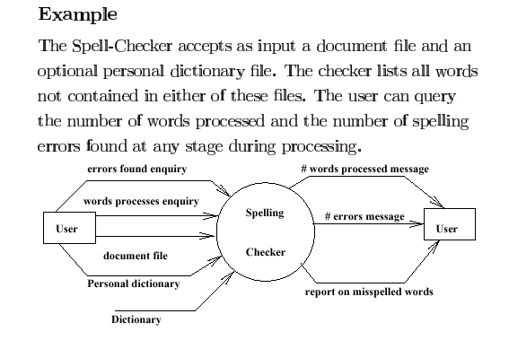

Slide 32
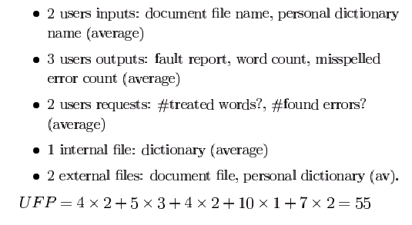
Example (.)

Slide 33
Example (..)
Technical Complexity Factors for Function Points: (0-5)
1. Data Communication 3
2. Distributed Data Processing 0
3. Performance Criteria 4
4. Heavily Utilized Hardware 0
5. High Transaction Rates 3
6. Online Data Entry 3
7. Online Updating 3
8. End-user Efficiency 3
9. Complex Computations 0
10. Reusability 2
11. Ease of Installation 3
12. Ease of Operation 4
13. Portability 0
14. Maintainability 3
DI =30 (Degree of Influence)
https://www.tutorialspoint.com/software_quality_management/software_quality_management_albrechts_function_point_method.htm

Slide 34
Example (…)
Function Points
FP=UFP*(0.65+0.01*DI)= 55*(0.65+0.01*30)=52.25
That means the is FP=52.25

Slide 35
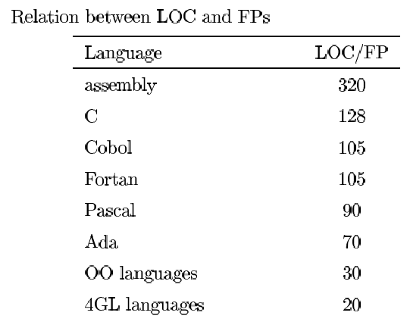
Relation between LOC and FP
Relationship:
LOC = Language Factor * FP
where
LOC (Lines of Code)
FP (Function Points)

Slide 36
Relation between LOC and FP(.)
Assuming LOC’s per FP for:
Java = 53,
C++ = 64
aKLOC = FP * LOC_per_FP / 1000
It means for the SpellChekcer Example: (Java)
LOC=52.25*53=2769.25 LOC or 2.76 KLOC

Slide 37
Effort Computation
The Basic COCOMO model computes effort as a function of program size. The Basic COCOMO equation is:
E = aKLOC^b
Effort for three modes of Basic COCOMO.
Mode | a | b
Organic | 2.4 | 1.05
Semi-detached | 3.0 | 1.12
Embedded | 3.6 | 1.20

Slide 38

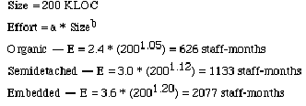
Example

Slide 39
Effort Computation
The intermediate COCOMO model computes effort as a function of program size and a set of cost drivers. The Intermediate COCOMO equation is:
E = aKLOC^b*EAF
Effort for three modes of intermediate COCOMO.
Mode | a | b
Organic | 3.2 | 1.05
Semi-detached | 3.0 | 1.12
Embedded | 2.8 | 1.20

Slide 40
Effort computation(.)
Effort Adjustment Factor
Cost Driver
Very
Low
Low
Nominal
High
Very
High
Extra
High
Required Reliability
.75
.88
1.00
1.15
1.40
1.40
Database Size
.94
.94
1.00
1.08
1.16
1.16
Product Complexity
.70
.85
1.00
1.15
1.30
1.65
Execution Time Constraint
1.00
1.00
1.00
1.11
1.30
1.66
Main Storage Constraint
1.00
1.00
1.00
1.06
1.21
1.56
Virtual Machine Volatility
.87
.87
1.00
1.15
1.30
1.30
Comp Turn Around Time
.87
.87
1.00
1.07
1.15
1.15
Analyst Capability
1.46
1.19
1.00
.86
.71
.71
Application Experience
1.29
1.13
1.00
.91
.82
.82
Programmers Capability
1.42
1.17
1.00
.86
.70
.70
Virtual machine Experience
1.21
1.10
1.00
.90
.90
.90
Language Experience
1.14
1.07
1.00
.95
.95
.95
Modern Prog Practices
1.24
1.10
1.00
.91
.82
.82
SW Tools
1.24
1.10
1.00
.91
.83
.83
Required Dev Schedule
1.23
1.08
1.00
1.04
1.10
1,10

